Slide 1
Tower defense design document (build 2.0)
Additional components with respect to build 1.0:
Overview of class diagram
Coupling between model and view thus complete implementation of MVC architecture
Implementation of 3 patterns: MVC, Observer pattern and Singleton pattern
Strategy for towers
Wave + level up functionality for critters
Damage effects on critters (burn , freeze.. etc)
Path algorithm for critter movement.
Level up functionality for towers
Complete class diagram.

Slide 2
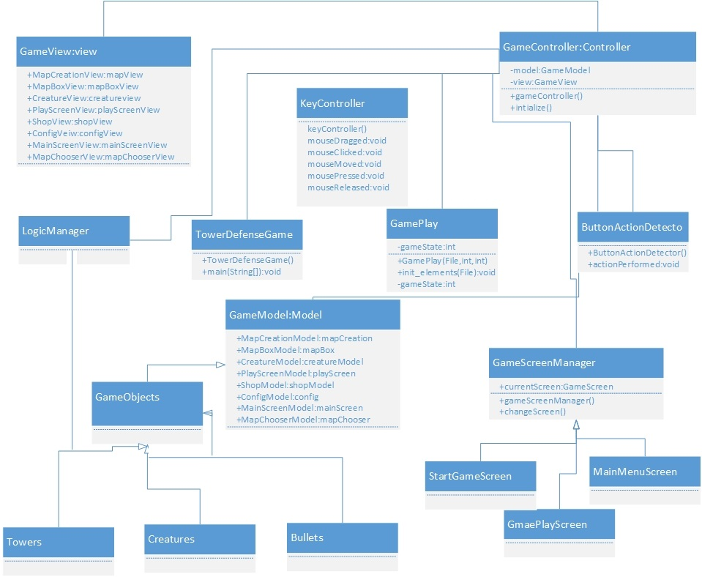
OVERVIEW OF CLASS DIAGRAM:

Slide 3

Why tight coupling between MODEL and VIEW?
Since the functionality of the critters is dependent on the level of the game that is their strength and speed is independent of user input and is an automated system thus it is not required to be controlled by the controller.
Hence any change in state for critter would be directly updated in the view by the model.
GAME MODEL
Map validation, map creation, towers..etc
Game Contorller
GAME VIEW
Data prepared by controller and model is then fed to the view
Update view based on data from model and controller

Slide 4
Why use a strategy for towers?
Since there are different types of towers thus we deduced an algorithm for them which basically decides how the towers will behave to enemy movement, for now we just added a predefined classic feature where the first tower in the sequence will kill the enemy that comes first in range that is first come first serve and rest of the towers will kill the very next enemy in the range.

Slide 5
Create private instance of view and model
In a controller class
If instance of the controller class =null
Create new instance of the class and initialize the model and view objects for once by calling the private constructor
yes
no
Return instance already created
Call getInstance in main game controller (towerdefense) using single objects class name

Slide 6
Why observer pattern?
When there is one to many functionality of the objects that is when a object of a class is modified as a result of which the dependent objects are required to be modified automatically, thus in our game scene a mouse event triggers a change to the shop controller(maintains all the buy and sell details) which notifies all the observers that is different types of towers by calling the update in the shop controller depending upon which type to of tower is selected or not.

Slide 7
OBSERVER
Observable / subject
observer
KeyController
Notifyall();
ShopController
Update();
Config model: Contains all static data for the game
MouseClickEvent
AirTower1
AirTower2
AirTower3

Slide 8
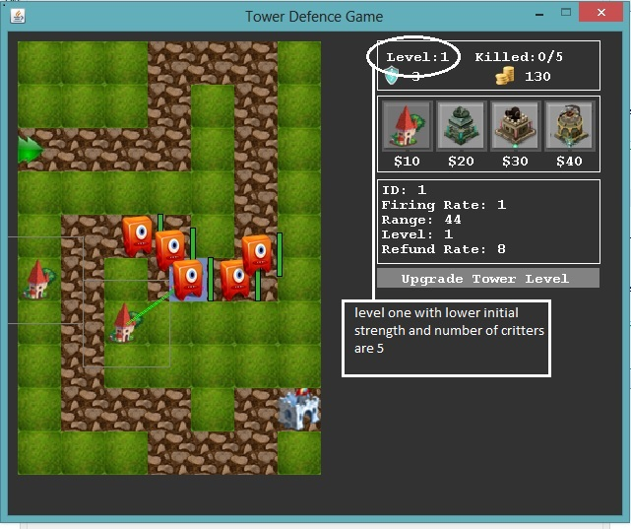
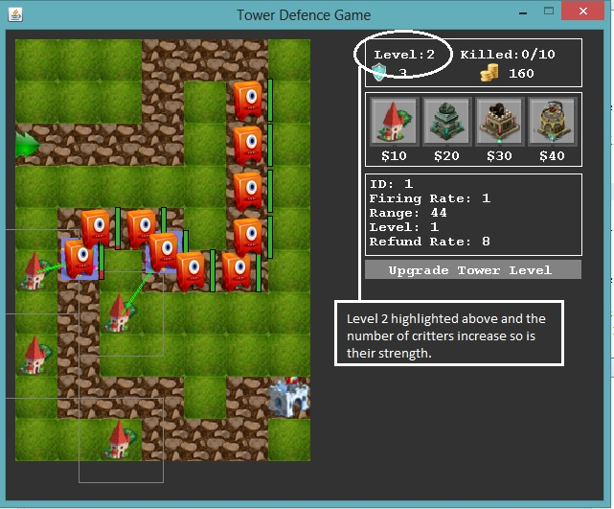
Why use wave and level up functionality of critters?
If only x amount of critters with same level of strength are used then user might loos interest in the game as it would be a easy win – win situation. Thus every time the user levels up in a game amount of critters are increased to 2x and the strength of the critters will also increase thus making it harder to kill them, following is the screenshot for the same:

Slide 9
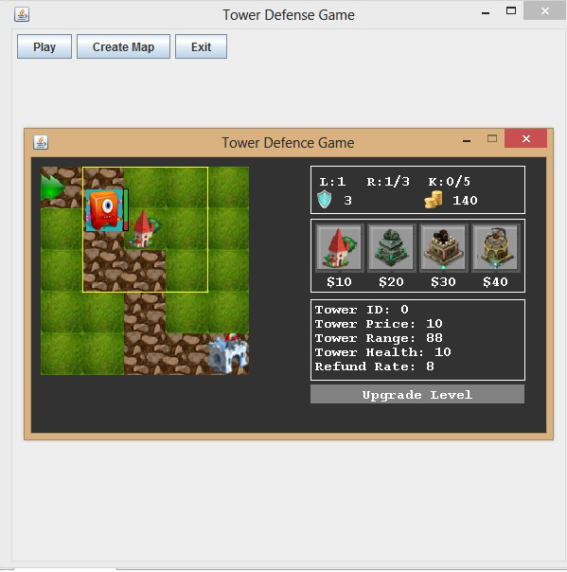
DAMAGE EFFECTS
SPLASH: spills water on the enemy

Slide 10
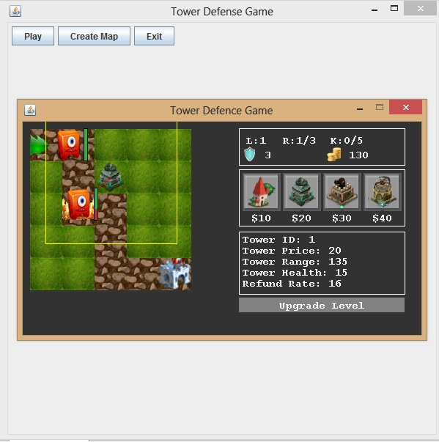
FIRE: burning effect to enemy higher damage

Slide 11
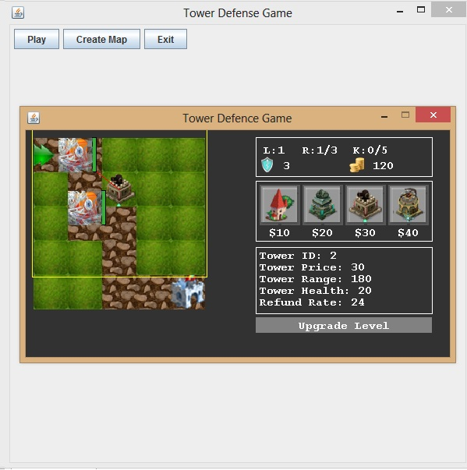
FREEZE: Slows down the enemy (critter)

Slide 12
Why choose an algorithm for critter movement?
When the user deploys the a path there may be a case where 2 or more paths would be there for critter movement, which will be clear by the following flow diagram , thus we required a appropriate algorithm to be implemented so that correct path is decided for critter movement.
Since the critter movement is based on the immediate next pixel available to him there might be a case as follows:
Confusion which path to choose
start
Stop

Slide 13
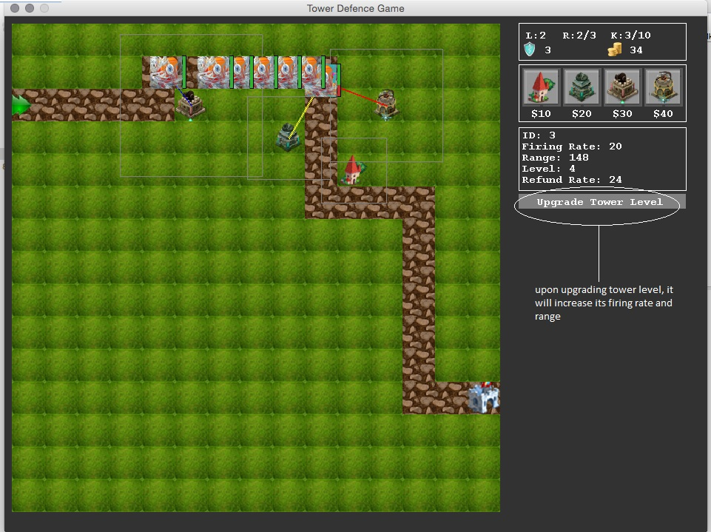
Level up for towers:

Slide 14
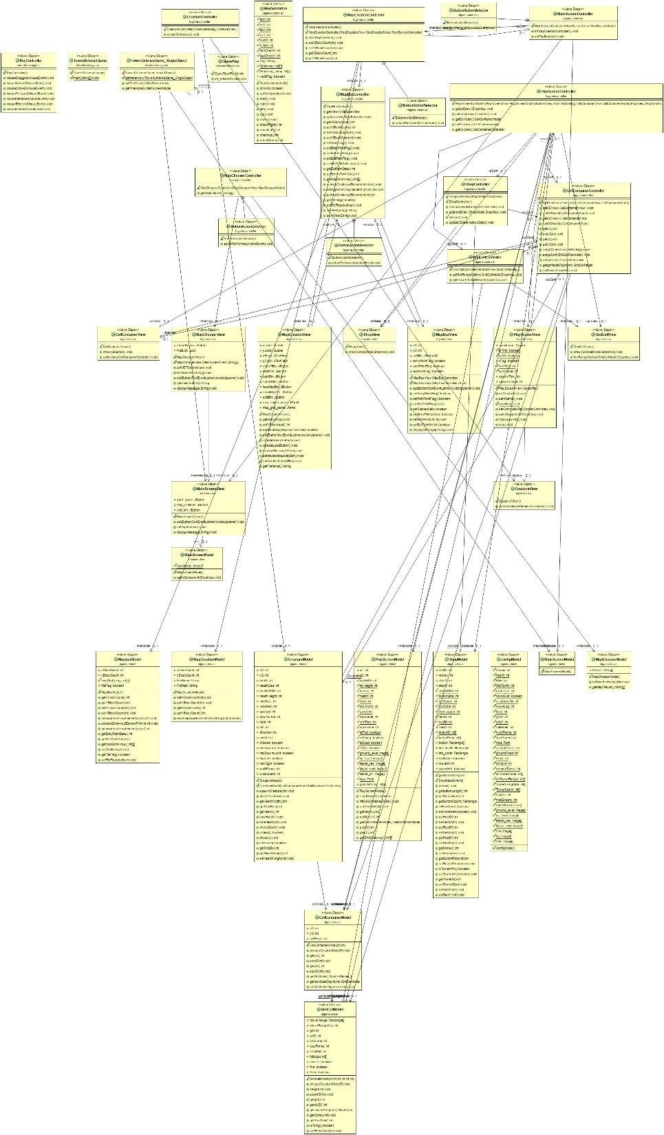
CLASS DIAGRAM:

